Slide 1



Slide 2
BOARD OF DIRECTORS

Slide 3
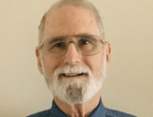
STEVE FORSYTHE
CHAIRMAN

Slide 4
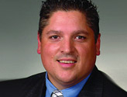
JOE LEMMONS
VICE CHAIRMAN

Slide 5
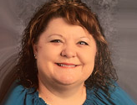
BEVERLEY SCHROEDTER
SECRETARY

Slide 6
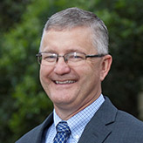
RAY PIENIAZEK
TREASURER

Slide 7
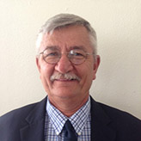
DON HENSON
DIRECTOR

Slide 8
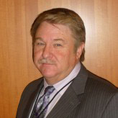
GARY ADAMS
DIRECTOR

Slide 9
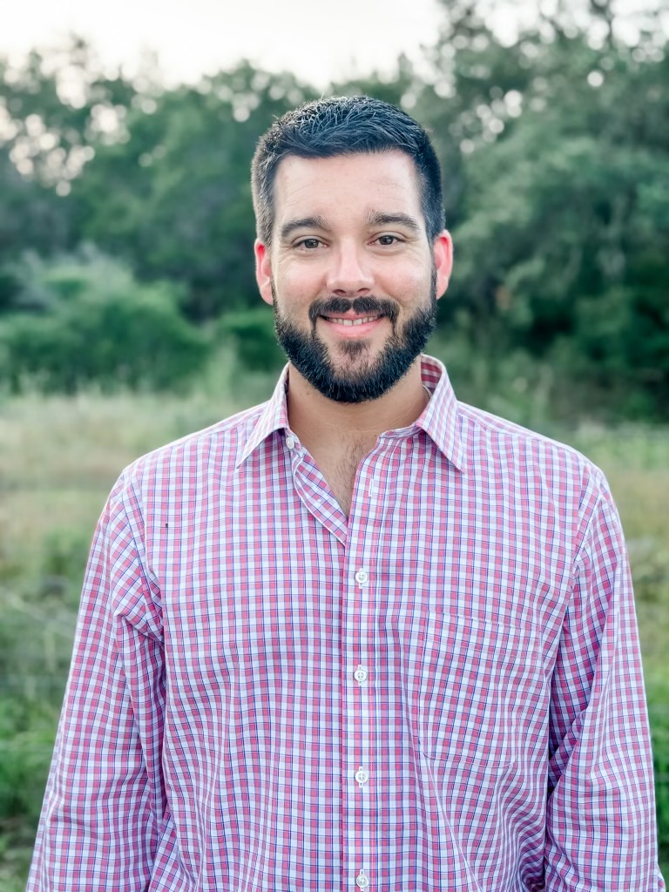
GARRETT SCHATTTE
DIRECTOR

Slide 10
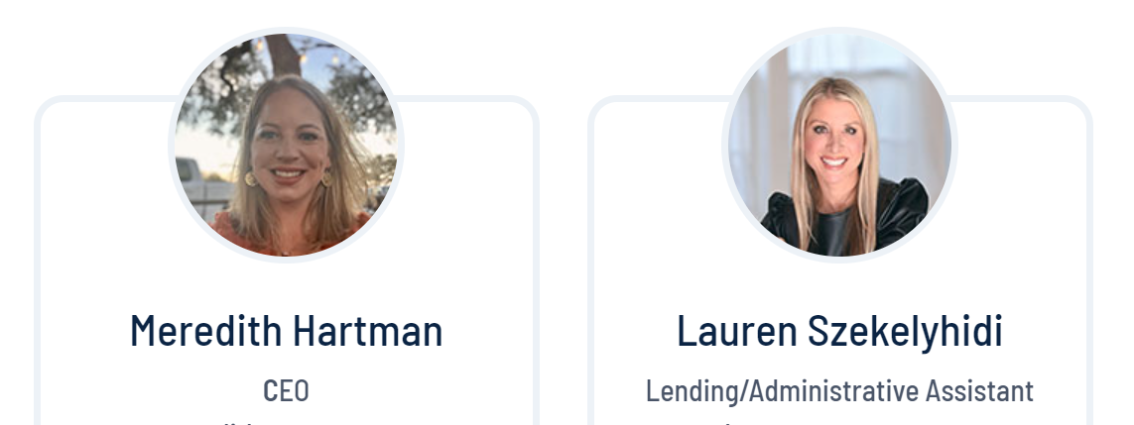

Slide 11
64th Annual Meeting Agenda
July 23, 2025
Steve Forsythe - Call meeting to order.
Joe Lemmons - Ascertain that a quorum is present.
Joe Lemmons - Appoint Recording Secretary, Beverley Schroedter
Don Henson - Invocation
Steve Forsythe - Welcome Message
Steve Forsythe - Reading and approval of the 2024 annual meeting minutes
Meredith Hartmann - CEO’s report/2024 Financials
Elections
Steve Forsythe & Beverley Schroedter - Door prizes
Steve Forsythe - Adjournment

Slide 12
VATAT Credit Union
Annual Meeting Minutes
July 24, 2024 * Dallas, TX
Steve Forsythe called the meeting to order at 12:15 PM.
Joe Lemmons ascertained that a quorum was present.
Invocation
Don Henson gave the invocation.
Welcome
Steve Forsythe welcomed everyone to the meeting. He introduced our CEO Meredith Hartmann and the rest of the board members.
Reading of the Minutes
Joe Lemmons moved and Steve Forsythe seconded that Beverley Schroedter would be recording secretary during the meeting.
Steve Forsythe read the minutes from 2023 annual meeting & reported that the credit union received annual audits and were found to be following all state regulations and received feedback that the credit union continues to be financially sound and in good standing. Minutes were approved by general consent.

Slide 13
President/Treasurer Report
Meredith Hartmann went over the financials of the credit union as of December 2023. The net income for 2023 was $173,157. Dividends paid to members was $97,140. Total loans to members were $9,287,675. The credit union will continue providing loans and other products and services to members to maintain steady growth.
Nominating Committee Report
Beverley Schroedter, appointed as the Chairman of the committee. Gary Adams & Don Henson were on the committee. The committee announced that there were three positions open, and three candidates were presented and introduced. The floor was open to nominations – there were no nominations from the floor. The candidates were approved and appointed by general consent.
Door Prizes
Garrett Schatte & Beverley Schroedter conducted the 2024 door prize drawing and awarded the cash door prizes – 5 @ $50, 5 @ $100 & 5 Payday Candy Bars
Adjournment
Steve Forsythe adjourned and dismissed at 12:58PM.

Slide 14
2024 DECEMBER FINANCIALS
Statement of Income and Expense
Operating Income | $ 672,763
Other Operating Gain or (loss) | $ -
Operating Expenses | $ 430,042
Net Income From Operations | $ 242,721
Dividends Paid to Members | $ 164,855
Net Income | $ 77,866
Statement of Financial Condition
Loans to Members | $ 8,926,650
Allowance for Loan Loss | $ (128,576)
Cash | $ 777,154
Investment | $ 849,000
Catalyst Corp Perpetual Contribute Capital | $ 1,362
NCUA Share Insurance Fund | $ 68,057
Account Receivable | $ -
Prepaid Expenses | $ 32,459
Accrued Income | $ 21,936
Fixed Assets | $ 10,923
Other Assets | $ -
Total Assets | $ 10,558,964

Slide 15
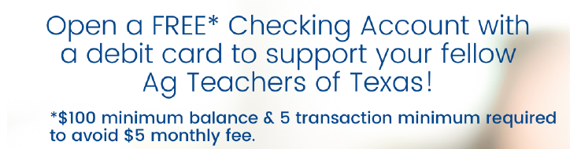
DEBIT CARDS & FREE CHECKING AVAILABLE NOW!

Slide 16
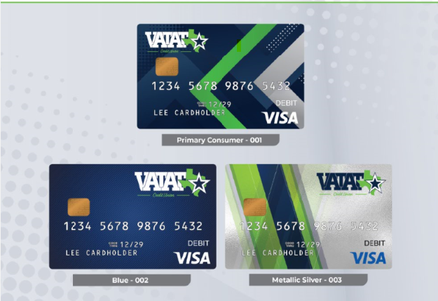
DEBIT CARDS

Slide 17
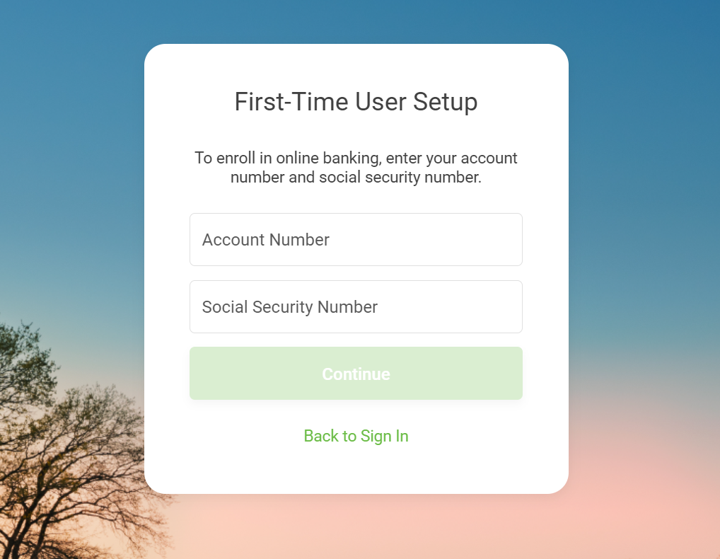
ONLINE BANKING
itsme247.com/367/setup-steps/enroll

Slide 18
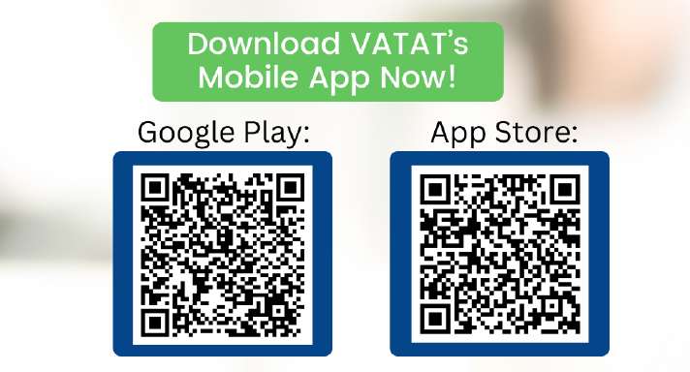

Slide 19
BOARD OF DIRECTOR ELECTIONS
NOMINATING CHAIR: Garrett Schatte
NOMINATING COMMITTEE: Joe Lemmons & Steve Forsythe
MEMBERS FOR ELECTION:
Gary Adams
Chris Cleveland
John Templeton
Curtis Langley

Slide 20
$$$$$$$$$$
DOOR PRIZE
DRAWING
$$$$$$$$$$

Slide 21
THANK YOU FOR ATTENDING OUR 64th ANNUAL MEETING!
SCHOOL SUPPLY DRIVE FOR CCISD – AREA WITH HEAVIEST WINS $1000 SCHOLORSHIP FUND.
BOOTH # 604

